Slide 1
What Does It Mean to Take ToP to Scale?
If you have a customer who wants to train 300-500 people in three months – how would you respond?

Slide 2
Funding expires 9/30
No budget for overnight stays
Only California Licensed Trainers & CTFs
Direct contracting not an option
5 Partnering Agencies
Train as many people as possible
It is summer
7 large geographic regions
Can only pay $125/ hour
Huge population

Slide 3
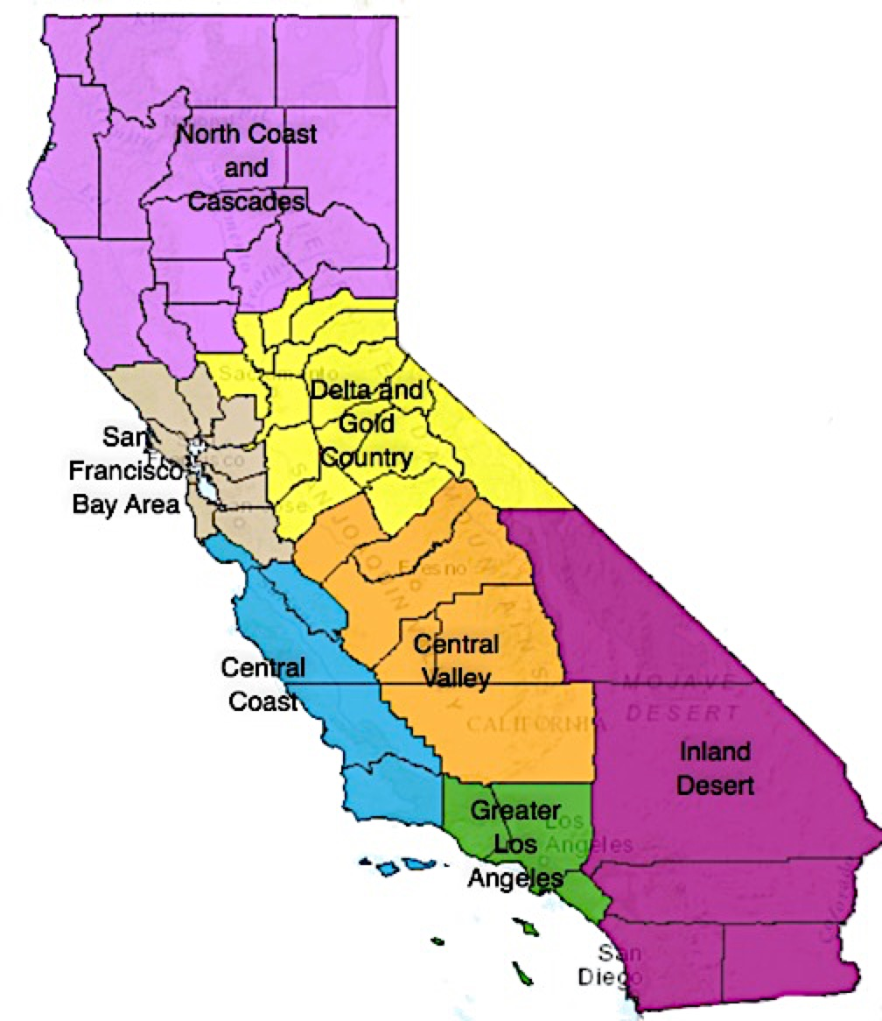

Slide 4
Isolated Players
Funding expires 9/30
Only California Licensed Trainers & CTFs
7 large geographic regions
Train as many people as possible
Huge population
Create coordinating point
Assess need and course options for client
Survey the Trainers – possibility and interest
Envision roll out strategy to 7 regions

Slide 6
No budget for overnight stays
Funding expires 9/30
It is summer
Train as many people as possible
Huge population
Enter at any point
All information is fresh
Customization required
One day stand alone modules
Focused Conversation
Consensus Workshop
Action Planning

Slide 7
Direct contracting not an option
Has to fit within SNAP-Ed budget
Maximum hourly rate $125
Training hours could be adjusted to increase effective hourly rate
Reaching Agreement:
Trainers compensated equitably
Compensation approximates commercially available rate for in house courses

Slide 8
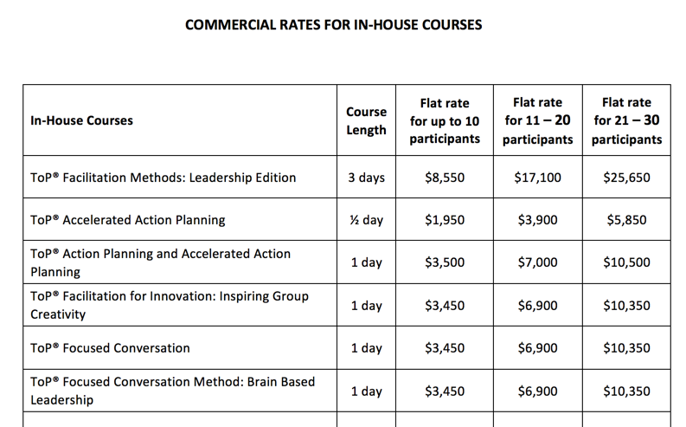

Slide 9
What’s in That Rate?
Seat fees
Manuals
Materials / supplies / handouts
Preparation
Travel
Trainer Time
Refreshments

Slide 10
What Challenges Present?
Predicting training slots in advance
Seat fees – royalties disallowed
Manuals – current manual exceeds need
Content – standardized for all modules
Materials / handouts – client will provide
Trainer Time – prep, travel and delivery bundled

Slide 11
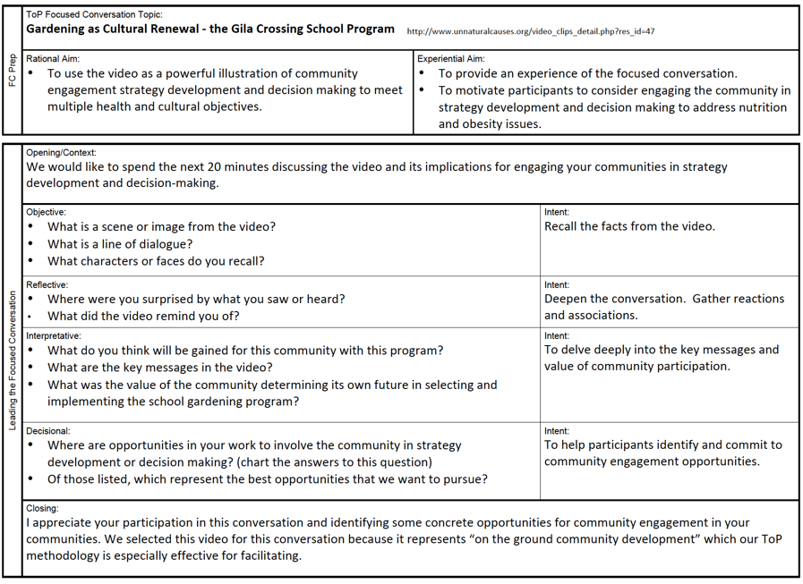
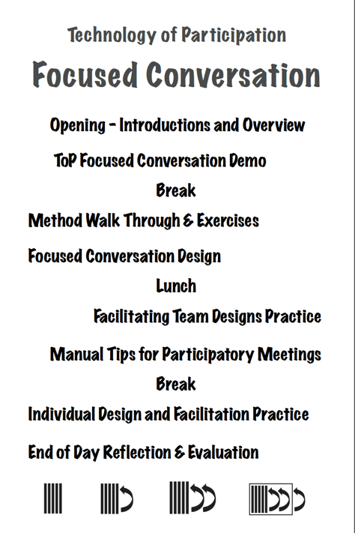
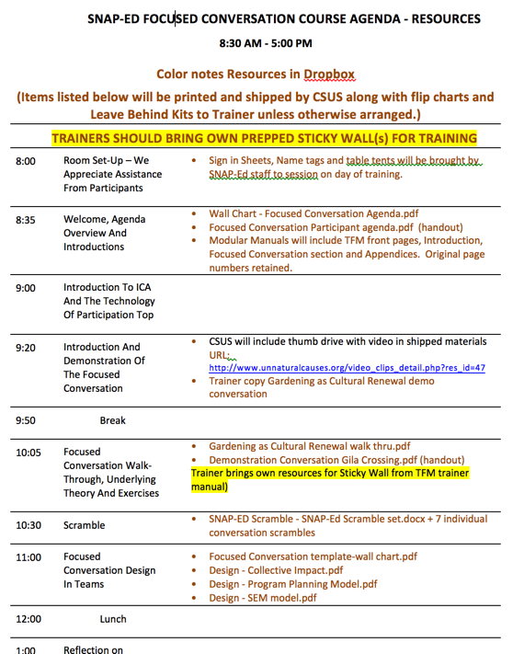
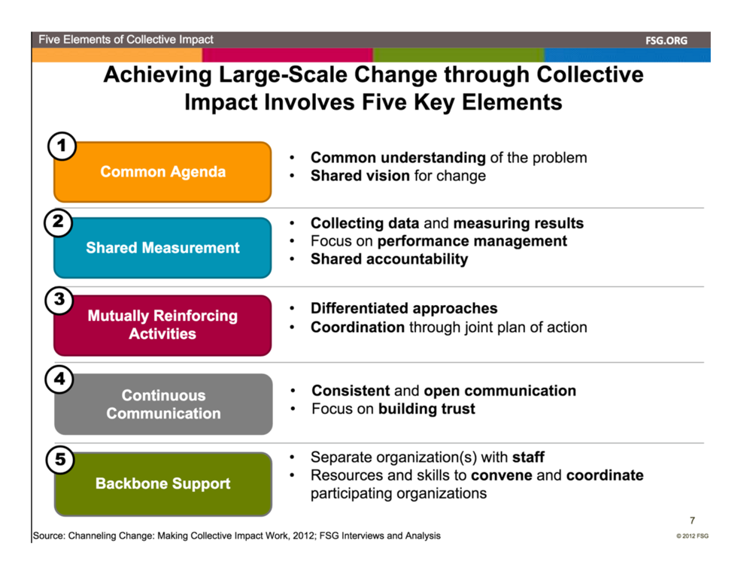
Wall Charts, Handouts

Slide 12
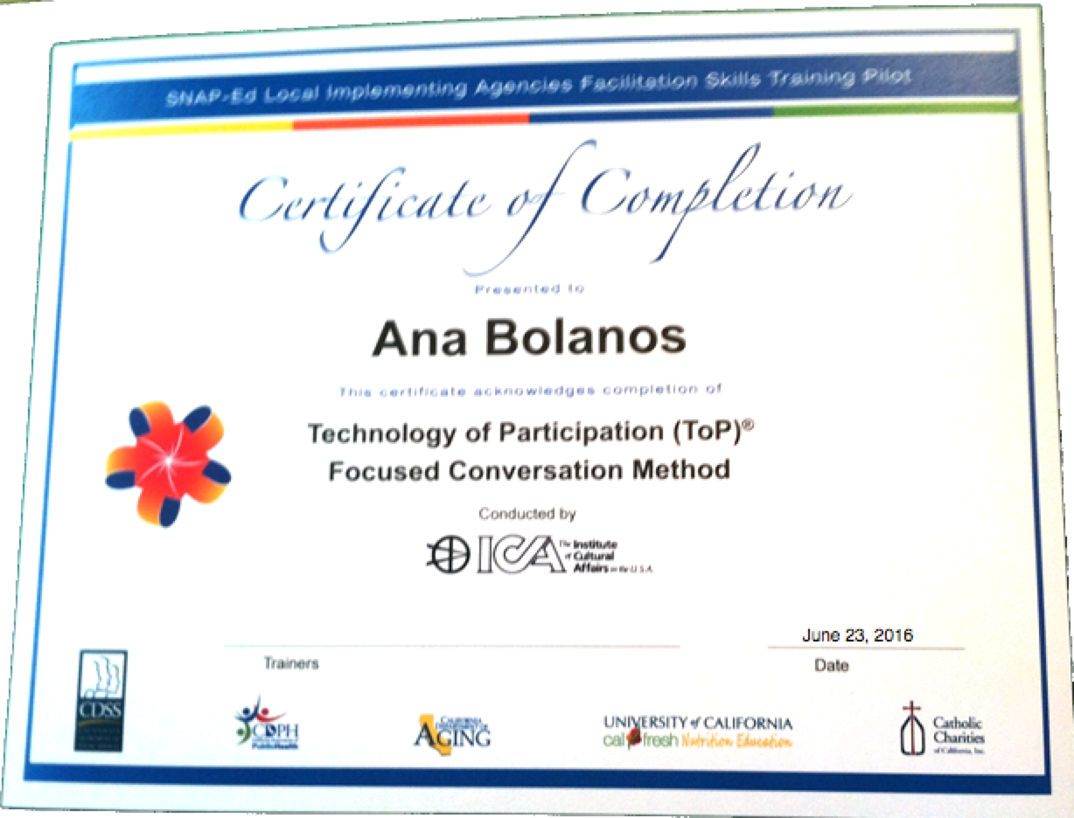
Leave Behind Kit, Signage, Name Tags, Table Tents, Certificates, Flip Charts
Post card for written intention
Leave Behind Kit – 1 per 10 registrants
Sticky Wall, spray
Tape
Markers
Session Supplies
Art of Focused Conversation
Raffle off at end

Slide 13
Terms
Two contracting tracks
Training
Coordination
Trainer Compensation per 1 day module
Co-trainer = $2,000
Lead trainer = $2,500

Slide 14
Training Values
Apprentices can only train with Mentors
One member of training team has experience with content
Equal opportunity to train
Trainer availability - days and geography
Minimize replicated pairings
Chat about the experience….

Slide 16
The Participants:
Needed - culture shift from SME to CD:
Nutrition - public health - education - social service
Many come from science background and appreciate exchanges that are concrete
Directly relatable content makes potential applications easier to imagine
Culture/style “inform and advocate rather than collaborate” Believe facilitation = training
Grand plans exceed execution skill

Slide 17
Now What?
Competency and sustainability
How do we ensure people are competently using methods after training?
How do we go beyond our knowledge evaluation at the end of training to really see if we are making an impact?
How do you mentor 300 people?

Slide 18
4=Strongly Agree, 3=Agree, 2=Disagree, 1=Strongly Disagree

Slide 19
3=Very Likely, 2=Somewhat Likely, 1= Not Very Likely

Slide 20
Consensus Workshop
What needs to be in place to make ToP scalable and impactful?
Seed questions:
How does a large customer enter our system?
What points of flexibility must we have to serve a large customer?
What do we need to know to respond when opportunity arises?
How can we determine the benefit to the agencies and the return on investment?
How do we develop an infrastructure that responds to large scale needs?

